Slide 1
Nuclear Fuel Performance
NE-533
Spring 2025

Slide 2
Last Time
Solid mechanics predicts the deformation of a body from its applied load
Elastic deformation and plastic deformation
Concepts of stress and strain
Elastic moduli and Elastic constants
Work hardening/strain hardening
Toughness, ductility, DBTT, etc.
Thin-walled cladding stresses

Slide 3
Mechanics

Slide 4
Small strain theory
In continuum mechanics, the infinitesimal strain theory is a mathematical approach to the description of the deformation of a solid body in which the displacements of the material particles are assumed to be much smaller than any relevant dimension of the body so that its geometry and the constitutive properties of the material at each point of space can be assumed to be unchanged by the deformation
With this assumption, the equations of continuum mechanics are considerably simplified
The small strain theory is commonly adopted in civil and mechanical engineering for the stress analysis of structures built from relatively stiff elastic materials

Slide 5
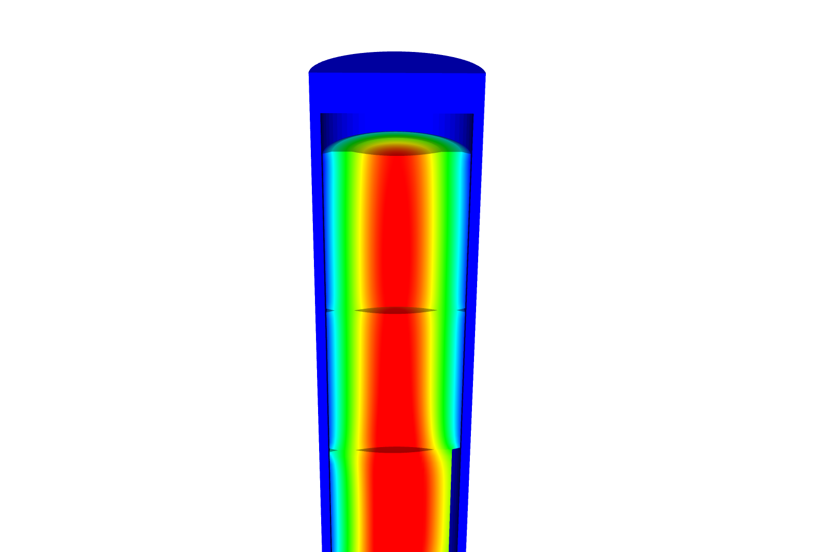
Develop constitutive relations for thick-walled
We assume small strains, so the strain is defined with respect to displacement: u
We assume isotropic material response:

Slide 6
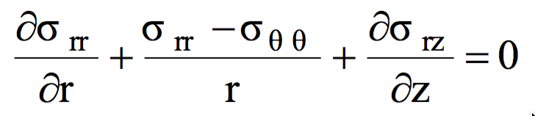
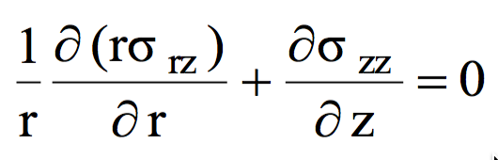
Stress within a pressurized cylinder that has thick walls (radius/thickness<20)
The cylinder as an inner radius R_{i} and an outer Radius R_{o}
We assume there is no shear stress, so σ_{rz} = 0
We will begin with the r equation
Now we need our constitutive law
We combine these equations to get

Slide 7
Develop equations for the stress within a pressurized cylinder with thick walls
We need one more relationship from the definition of the strain
From the previous slide, we have
If we combine these, we get
Again, from the previous slide
We end up with

Slide 8
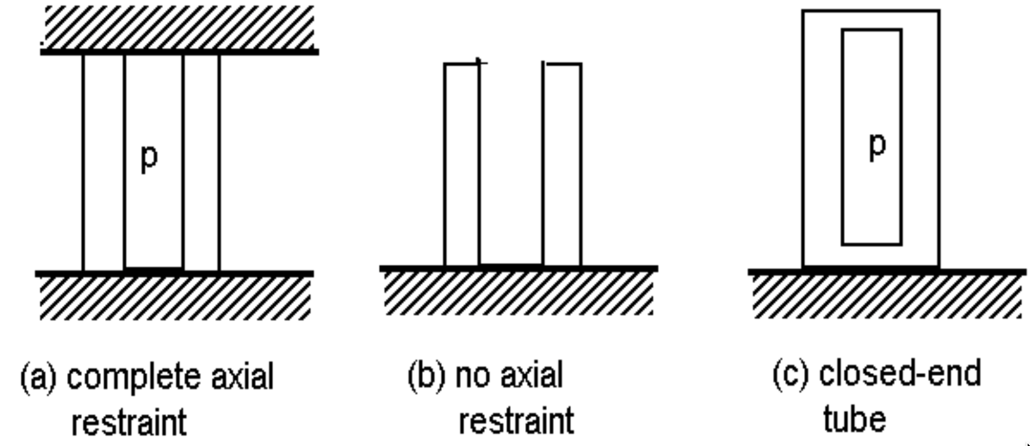
We now have an ODE so we can solve to get the stress
Our boundary conditions are σ_{rr}(R_{i}) = -p and σ_{rr}(R_{o}) = 0
After integrating twice, we get
From σ_{rr}, we can get σ_{θθ} from
From the end condition, we determine σ_{zz}
(a)
(b)
(c)

Slide 9
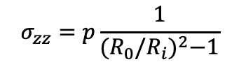
Determine if a fuel rod will exceed its yield stress
A fuel rod has an initial pressure of 5 MPa that increases to 9 MPa during operation. Will it exceed its yield stress?
R_{i} = 0.52, R_{o} = 0.58 cm, σ_{y} = 381 MPa
$$σ_{zz}=p\frac{1}{{(R_{0}/R_{i})}^{2}−1}$$
Which stress is the largest?
σ_{θθ}
At what position r will the hoop stress be the largest?
r = R_{i} = 0.52 cm
What is the stress at p = 5 MPa?
σ_{θθ} = 5*((0.58/0.52)^2 + 1)/((0.58/0.52)^2 – 1) = 46.0 MPa
What is the stress at p = 9 Mpa?
σ_{θθ} = 9*((0.58/0.52)^2 + 1)/((0.58/0.52)^2 – 1) = 82.7 Mpa
Again, we don’t even get close to yielding

Slide 10
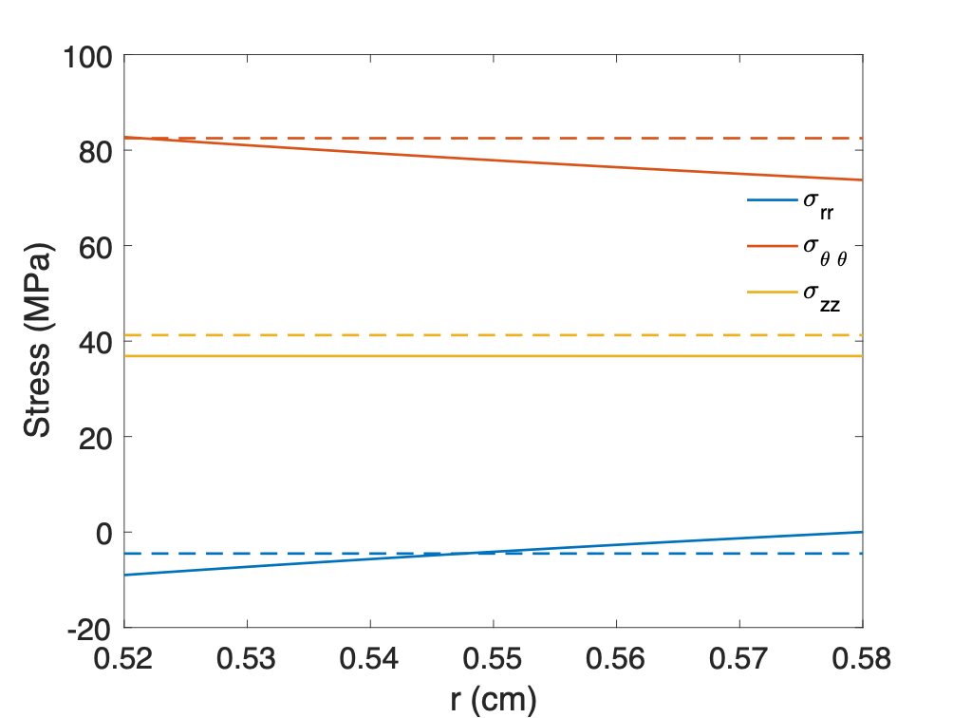
We’ve now solved this same problem assuming thin and thick-walled cylinders

Slide 11
THERMO-Mechanics

Slide 12
Thermal Expansion
As the temperature increases, atoms have larger vibrations, causing the material to expand
This expansion doesn’t raise the energy of the material when unrestrained
This expansion can be treated as a strain, but as one that doesn’t cause stress

Slide 13
Thermal Expansion
In isotropic materials, thermal expansion happens equally in all directions and is linear with temperature
$ε_{0}=\left(T − T_{0}\right)αI$
In this equation
T is the current temperature
T₀ is the temperature the original size was measured
α is the linear thermal expansion coefficient
I is the identity tensor

Slide 14
Thermal Expansion
Though thermal expansion doesn’t directly cause stress, it can still lead to thermal stress

Slide 15

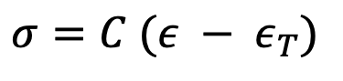
What is the stress in a thin constrained rod of length L when it is heated to ΔT?
The rod has a Young’s modulus of E and an expansion coefficient of α
$$ε_{T}=\left(T − T_{0}\right)αI$$
$σ=C (ε − ε_{T})$
$$ε_{0}=\left(T − T_{0}\right)α$$
$σ=E (0 − ΔTα)$
$σ=−EΔTα$

Slide 16
The large temperature gradient within a fuel pellet results in large thermal stresses

Slide 17
Consider the constitutive relations plus T
We assume small strains, so the strain is defined as
We assume isotropic material response, so

Slide 18

Consider a cylinder with thermal expansion but not pressure
$σ_{rr}\left(R_{i}\right)=σ_{rr}\left(R_{0}\right)=0$
Similar to the equations we worked through before
$\frac{1}{r^{3}}\frac{d}{dr}\left(r^{3}\frac{dσ_{rr}}{dr}\right)=−\left(\frac{αE}{1−ν}\right)\frac{1}{r}\frac{dT}{dr}$
Solving this ODE:

Slide 19
What is the hoop stress in the cladding?
$$σ_{θθ}$$
r
R_{i}
R_{f}

Slide 20
Where is hoop stress equal to zero?
$$σ_{θθ}\left(r\right)=\frac{1}{2}ΔT\frac{αE}{1−ν}\left(1−2\frac{R_{i}}{δ}\left(\frac{r}{R_{i}}−1\right)\right)=0$$
$$\left(1−2\frac{R_{i}}{δ}\left(\frac{r}{R_{i}}−1\right)\right)=0$$
$$\left.2\frac{R_{i}}{δ}\left(\frac{r}{R_{i}}−1\right)\right.=1$$
$$\left.\left(\frac{r}{R_{i}}−1\right)\right.=\frac{δ}{{2R}_{i}}$$
$$\left. r\right.=\frac{δ}{2}+R_{i}$$

Slide 21
The linear temperature gradient across the cladding causes axial thermal stresses

Slide 22
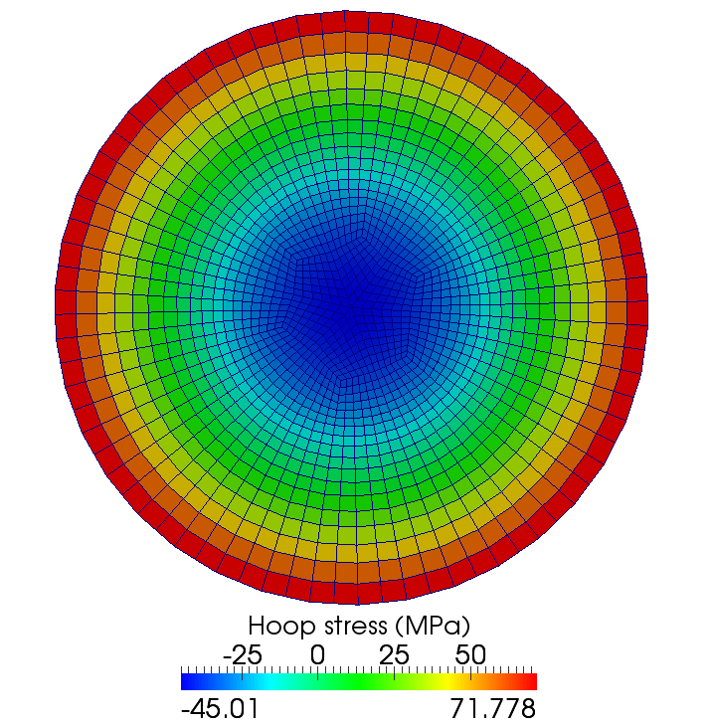
Same approach to the thermal stress in a fuel pellet
The thermal stress is due to the temperature gradient

Slide 23
Solve this stress ODE
The boundary conditions are:
Once we solve it, we obtain
Then we can solve the hoop stress
The axial stress is more complicated to obtain, but you end up with

Slide 24
The fuel temperature gradient causes large thermal stresses

Slide 25
Example

Slide 26
How far do fuel cracks extend?
E = 200 GPa, ν = 0.345, α = 11.0e-6 1/K, σ_{fr} = 130 MPa, ΔT = 550 K
Solve for η
– σ_{fr} / σ* = 1 – 3 η²
3 η² = 1 + σ_{fr} / σ*
η = ( (1 + σ_{fr} / σ*)/3 )^{½}
σ* = 11.0e-6*200*550/(4*(1 – 0.345) ) = 461.8 MPa
η = sqrt( (1 + 130/461.8)/3 ) = 0.65

Slide 27
thermal expansion

Slide 28
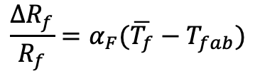
The gap changes as a function of time
Both the pellet and the cladding swell
But, as the gap decreases, the temperature changes, which again makes the gap change
The solution using the analytical equations is iterative, due to the dependence of the gap size and temperature
$$\frac{∆R_{f}}{R_{f}}=α_{F}(\overline{T_{f}}−T_{fab})$$

Slide 29
Example

Slide 30
Calculate the steady state temperature profile in the rod, including thermal expansion
LHR = 200 W/cm, δ⁰_{gap} = 30 μm, R_{f} = 0.6, T_{co} = 600 K, T_{EXP,0} = 373 K, k_{gap} = 0.0026 W/cm-K, t_{C}= 0.06 cm, α_{f} = 11.0e-6 1/K, α_{C} = 7.1e-6 1/K
So, T_{IC} = 600 + 18.7 = 618.7 K, T_{s} = 679.9 K, T₀ = 1210.5 K
First, we will deal with expansion in the cladding
Av(R_{c}) = 0.6 + 30e-4 + 0.06/2 = 0.633 cm
Av(T_{C}) = (600+618.7)/2 = 609.4 K
ΔR_{c} = 0.633*7.1e-6*(609.4 – 373) = 0.0011 cm
$$= ΔR_{c}−ΔR_{f}$$

Slide 31
Calculate the steady state temperature profile in the rod, including thermal expansion
Second, we deal with the fuel
Av(Tf) = (1210.5 + 680)/2 = 945.25 K
ΔR_{f} = 0.6*11e-6*(945.3 – 373) = 0.00378 cm
The total change in the gap is 0.0011 – 0.0038 = -0.0027
However, that means the gap is smaller and so our temperatures were wrong!

Slide 32
This calculation is repeated until the gap width stops changing significantly
The change in the gap does NOT affect the coolant or outer cladding temperatures, just the gap and fuel temperatures
Does fuel centerline temp go up or down with correction?
Iteration | δ_{gap} (cm) | T_{s} (K) | T₀ (K)
0 | 0.003 | 701 | 1232
1 | 0.00066 | 644 | 1174
2 | 0.00097 | 652 | 1182
3 | 0.00094 | 651 | 1181
4 | 0.00094 | 651 | 1181

Slide 33
last bit of Mechanics

Slide 34
Relating Displacements to Stress
We have been determining the stress due to some internal pressure (or temperature)
Often, the information more readily obtainable are the displacements
Utilizing the previous equations, can use displacement to stress relationships for our geometry

Slide 35
Assuming problem is axisymmetric

Slide 36
Solve for the stress from the strain
Assume isotropic materials
Can perform matrix multiplication for the calculation of the stress, given the displacements

Slide 37
Further simplify the problem to be 1D
No change in Z:

Slide 38
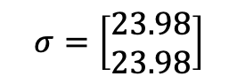
Determine the strain and stress in the pellet for 1D case
Assume the radial displacement in the fuel pellet is u_{r}(r) = 0.05r cm.
What is the strain tensor? At the outer edge:
We are dealing with UO₂, so E = 200 GPa and ν = 0.345
C₁₁ = E (1 – ν)/((1+ν)( 1–2 ν)) = 200*(1–0.345)/(1.345*(1–2*.345)) = 314.2 Gpa
C₁₂ = E ν/((1+ν)( 1–2 ν)) = 200*0.345/(1.345*(1–2*.345)) = 165.5 Gpa
Now we can calculate the stresses
σ_{rr} = 0.05*314.2 + 0.05*165.5 = 23.98 GPa
σ_{θθ} = 0.05*165.5 + 0.05*314.2 = 23.98 GPa
$$σ=\left[\begin{matrix}23.98 \\ 23.98\end{matrix}\right]$$

Slide 39
Example problem
Compute the stress and strain tensors in the center and at the outer edge (r = 0.5 cm) in 1D axisymmetric coordinates in a fuel pellet with u_{r}(r) = r²/5. C₁₁ = 314.2 Gpa, C₁₂ = 165.5 Gpa.
First, calculate the strain tensor
ε_{rr} = u_{r,r} = 2r/5
ε_{θθ} = u_{r}/r = r/5
At the center there is no strain; at the outer edge
To calculate the stress, convert to a strain vector and multiply by elastic constant matrix
The stress in the center is zero
On the outer edge
σ_{rr} = 0.2*314.2 + 0.1*165.5 = 79.4 GPa
σ_{θθ} = 0.1*314.2 + 0.2*165.5 = 64.52 GPa

Slide 40
Summary
We derived two analytical solutions for the stress in a pressurized cylinder
Thin-walled cylinder
Thick-walled cylinder
Increases in temperature cause most materials to expand
We call this thermal expansion, which is a strain that doesn’t inherently cause stress
Thermal expansion can cause stress when
Deformation is constrained
There are gradients in the expansion coefficient
There is a temperature gradient
We developed analytical equations for thermal stresses
in the cladding
in the fuel

